Slide 1


Lecture for Jewish Studies Assignment
to School-Centred Initial Teacher Training trainees
Presented by Jeremy Richards MA (ICT in Ed.)
27th January 2017
Title:
“Curriculum integration can generally be defined as a curriculum approach that purposefully draws together knowledge, skills, attitudes and values from within and across subject areas to develop a more powerful understanding of key ideas.”

Slide 2
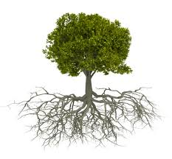

To the young mind everything is individual, stands by itself. By and by it finds how to join two things and see in them one nature, then three, then three thousand; and so, tyrannized over by its own unifying instinct, it goes on tying things together, diminishing anomalies, discovering roots running under ground, whereby contrary and remote things cohere and flower out from one stem.

Slide 3

It presently learns that since the dawn of history there has been a constant accumulation and classifying of facts. But what is classification but the perceiving that these objects are not chaotic and are not foreign, but have a law which is also a law of the human mind?
The astronomer discovers that geometry, a pure abstraction of the human mind, is the measure
of planetary motion. The chemist finds proportions and intelligible method throughout matter; and science in nothing but the finding of analogy, identity, in the most remote parts.

Slide 4
The ambitious soul sits down before each refractory fact; one after another, reduces all strange constitutions, all new powers, to their class and their law, and goes on for ever to animate the last fiber of organization, the outskirts of nature, by insight.
Ralph Waldo Emerson (1803–82)
http://www.bartleby.com/268/8/33.html

Slide 5
Recommended Reading for Assignment
*Beane, J. A., (1997). Curriculum Integration: designing the core of democratic education. New York and London: Teachers College, Columbia University.
*Fogarty, R.,( 2009). How to integrate the curricula. 3rd ed. California: Corwin.
*Bieler, J., (1986) Integration of Judaic and General Studies in the Modern Orthodox Day School. Jewish Education 54, 4 (1986), pp. 15-26. [online].
Available at www.lookstein.org/integration/bieler.htm#_ednref35.
*Malkus M (2011) Curriculum Integration in Jewish Day Schools: The Search for Coherence, in Miller H, Grant L.D., Pomson A, (2011) The International Handbook of Jewish Education, Dordrecht Heidelberg London New York: Springer
* Pomson, A (2001) “Knowledge that Doesn't Just Sit There: Considering a Reconception of the Curriculum Integration of Jewish and General Studies", Religious Education 96:4 (Fall, 2001), 530-32

Slide 6
More Recommended Reading for Assignment
*Sterling Epstein, S., (1991) . Integrated and Interdisciplinary Education. BeYachad – Bringing Together Best Educational Practices and Jewish Education. Philadelphia: BeYachad
*Valins, Oliver (2001) JPR – The Future of Jewish Schooling
*Zeldin, M., (1998). Integration and Interaction in the Jewish Day School. In: Robert Tomberg (ed.), 1998. The Jewish Educational Leader's Handbook.
Denver: A.R.E., pp. 579 – 590.
*Greenberg, I (2012) The Jewish Way: Living the Holidays
* education.alberta.ca/media/656618/curr.pdf
Primary Programs Framework For Teaching and Learning
* www.lookstein.org/integration/curriculum_intro.htm
Good curriculum Integration Site

Slide 7
INTEGRATION OF JUDAIC AND GENERAL STUDIES
IN THE MODERN ORTHODOX DAY SCHOOL
Jack Bieler
I. Compartmentalization
Harold S. Himmelfarb writes,
"Recent observers have commented… on the tendency of modern Orthodox Jews to compartmentalize the religious and secular components of their lives. It is quite possible that this tendency is fostered by the organization of the day school curriculum”

Slide 8
What might these analyses of "compartmentalization," "modern Orthodoxy," and their interrelationship suggest in terms of the direction of educational policy in modern Orthodox day schools?

Slide 9
Many Orthodox Jews in America, who, according to Gittelson, can be identified among the country’s leading "scientists, film stars, journalists, television executives, doctors, lawyers, university professors, and real estate tycoons engage in compartmentalization comparable to that of the Brahmins described by Singer.
Rather than residing in one continuous world, they see themselves as participating in multiple environments, constantly alternating between one and the other

Slide 10
II. Parallels between the Day School and Compartmentalization
In most of these schools, instructional time is divided into two distinct segments, where part of the day is devoted to Judaic studies and the other to secular disciplines. There are some schools that opt for a departmental approach where a class in Talmud can follow one in mathematics and be followed by another in English literature.
But within both organizational schemes, a secular discipline rarely impinges upon or overlaps aspects of the Judaic course of studies and vice versa.

Slide 11
The student is exposed to different outlooks, ideas, and ways of thinking as he goes from morning to afternoon, or from class to class. Adult role models are usually clearly identified with either Judaic or general studies, but rarely with both.
Extracurricular activities generally reflect the religious or secular orientations of those who organize and conduct them. The day school can therefore be understood to have prepared its graduates to continue compartmentalization during their university studies and well beyond, into their adult lives.

Slide 12
III. Rationale and Motivation
Ideologically, compartmentalization on the part of Orthodox Jews is rationalized by applying the categories of Kodesh and Chol to the domains of ritual and belief on the one hand, and worldly activities on the other

Slide 13
The Havdalah of Motzei Shabbat that divides the sanctity of the previous 25 hours from the secular quality of the ensuing work week serves as a paradigm for keeping religious considerations distinct from business, social, professional, and academic interests.

Slide 14
Furthermore, the degree of specialization in all aspects of life demanded by the technological sophistication of modern society also promotes the tendency to view religion as yet another specialty among an individual's multiple activities.

Slide 15
A religious orthodoxy that makes all-encompassing demands upon its faithful is particularly susceptible to being rejected in favor of a more liberal or even irreligious position that allows the individual increased personal freedom and easier acceptance by general society.
The alternative to such extensive soul-searching is compartmentalization, which presents the opportunity for the religiously Orthodox to feel that he has not compromised his traditional theological standards, while at the same time he can fully participate in the world around him.

Slide 16
IV. Another Model of Compartmentalization
According to Heilman, however, compartmentalization often not only entails separation, but also devaluation of at least one of the elements being kept apart from the other.
Either certain aspects of religion will be accorded less importance, or features of modern life and thought will be ignored. Devaluation is necessitated because of the “porousness” of modern society in which its diverse elements "leak" from one domain to another via the media, social contacts, and professional responsibilities.

Slide 17
In the case of Orthodox Jews, the daily newspaper introduces into the home advertisements that promote the materialism of general society;
being invited to a business associate's home for dinner may create numerous Kashrus dilemmas;
the scheduling of a professional conference on Shabbat gives rise to another set of conflicts for the observant Jewish participant.

Slide 18
…in order for him to maintain the delicate balance between his religious and secular pursuits, “the discordant matters are either made peripheral, inattended; or they are actively repressed and forgotten, disattended”.
As a result, some religious individuals approach modernity in purely instrumental terms. For example, the orthodox religionist may take advantage of financial opportunities, advanced and affordable medical treatment, and even technological developments that allow for wide dissemination of religious thought and learning.

Slide 19
Yet he will make sure to avoid serious consideration of the implications of modern thought vis-à-vis his religious beliefs. Secular education will be tolerated only as a vocational stepping-stone, rather than viewed as a possible forum wherein the student's understanding of how the elements in the divinely created universe function and interact with one another.

Slide 20
On the other hand, there are those for whom secularism and participation in the modern world are considered the "paramount reality," rather than the commitment to religious thought and practice.
While unwilling to reject outright their spiritual traditions, these individuals will often make sure to confine their religiosity to familiarity and conformity with the law. Activities that would allow religion to react as a more central focus in their lives, such as the careful and reflective study of traditional texts in order to better clarify the fundamentals of one's belief, are assiduously avoided.
D. Singer asserts that such people, albeit nominally identifying with Orthodoxy, are in fact "religiously observant secularists" who may be "meticulously observant of the law, but (whose) values and attitudes are shaped by the surrounding secular culture.

Slide 21
V. Devaluation in the Day School
Just as structural compartmentalization can be observed in the typical Orthodox day school, so attitudinal devaluation of either Judaic or general studies is also in evidence.
Answers to the following questions can provide a profile of what a particular school to values and devalues in terms of its dual curricular educational program:

Slide 22
1. Is the ideal graduate in the eyes of the administration, faculty and student body, one who continues to study Torah in a Jewish institution, or one who enrolls in a secular university, or both?
2. How many classroom hours are devoted to Judaic as compared to general studies?

Slide 23
3. When classes have to be canceled in order to allow for extracurricular activities to take place, which subjects are protected, and which subjects is the school prepared to regularly forgo?
4. Is the professional preparation and education of the Limudei Kodesh staff comparable in quality and breadth to that of those teaching Limudei Chol and vice versa?

Slide 24
5. Do the teachers communicate to their students’ proper respect for the disciplines of the department in which they do not teach?
6. Are the grades in all subjects in terms of school awards and acceptances to institutions of higher learning treated with equal significance?

Slide 25
7. Are aspects of traditional Halachic practice- overlooked in favor of taking part in secular activities, e.g., standards on school trips, the type of plays chosen for student performance, or the attire of a school athletic team?
Unbalanced approaches to issues such as the distribution of classroom hours, the type of professional training required, for employment, and the importance of evaluations of student classroom performance, contribute to the development of an outlook that might lead to devaluation of either the Jewish or secular worlds, both during and subsequent to a student's school career.

Slide 26
VI. Modern Orthodoxy, Compartmentalization, and Devaluation
The modern Orthodox Jew is expected to not only externally conform to traditional religiosity, but also to have intemalized the values and attitudes associated with orthodoxy. His "modernity" manifests itself in his willingness to participate in modern society rather than in an uncritical acceptance of contemporary values.

Slide 27
…if educational strategies were to be developed that would mitigate against compartmentalization and devaluation, and instead promote integration of the diverse elements comprising the students' immediate world perhaps the modern Orthodox adult culture could also be positively affected.

Slide 28
…it is wishful thinking on the part of modern Orthodox educators to assume that their students will integrate rather than compartmentalize and devaluate the "materials," i.e., either the Judaic or general studies aspects of their educations.
The sophisticated and complex task of integrating Jewish and secular studies and lifestyles should hardly be left to the average day school student to undertake on his own.

Slide 29
If the integration of Jewish learning and culture with the best aspects of Western civilization is to be more than an educational slogan designed to convince parents to provide their children with a day school education, then the school itself must actively and consciously design integrated curricular and extracurricular activities on behalf of its student body.

Slide 30
A theoretical scheme of integration that is appropriate to the background, aspirations, and religious orientation of the constituency served by the modern Orthodox day school must be arrived at and then translated into a meaningful educational program.
and you read the rest.....
http://www.lookstein.org/integration/bieler.htm#_ednref35

Slide 31
Digest of Literature on Curriculum Integration
Stan Peerless
The integration of Jewish and general studies has been identified as a common goal of many Jewish day schools, particularly those in the Modern Orthodox and non-Orthodox movements (Pomson, 1996; Solomon, 1984). Yet, researchers of Modern Orthodox, Conservative, and Reform Jewish education have all indicated that integration efforts in the day schools affiliated with these movements have generally been a source of disappointment (Bieler, 1986; Lukinsky, 1978; Zeldin, 1992).

Slide 32
Pomson claims that the failure of integration programs often relates to the complexity of the subject matter, the backgrounds of the teachers, the perspectives of the students, and/or the prevailing values of the community.

Slide 33
Why Integrate ?
Jewish educators are motivated to foster curriculum integration for both academic and ideological reasons. Such integration offers several potential academic benefits:
1) Curriculum integration fosters the ongoing reinforcement of skills and information learned in one area of study when utilized in another area.
2) Curriculum integration provides students a richer academic experience by broadening the context and applicability of information and skills that are learned.

Slide 34
3) Curriculum integration maximizes the utilization of learning time by “borrowing” from one area to support another. This is particularly important in Jewish day schools where educators face time pressures in all curricular areas.
On an ideological level, curriculum integration helps to create holistic students who are able to see the relevance of their Judaism in all areas of their lives. This prevents compartmentalization in which students separate between the religious and secular aspects of their lives. Such separation can lead to competition between the two worlds, with the Jewish component often losing out.

Slide 35
What Is Integration ?
We might find valuable insights into the issue of curriculum integration in the literature in general education. A common misconception among Jewish educators is that curriculum integration by definition involves interdisciplinary study.
Fogarty (1991) identifies ten models of integration that fall into three general categories:

Slide 36
integration within single disciplines
integration across several disciplines
integration within and across learners.
She defines the goal of integration as follows:
“to help young minds discover roots running underground whereby contrary and remote things cohere and flower out from one stem.” (p. 61)

Slide 37
As such, integration represents a way of thinking rather than simply an overlapping of curriculum. Perkins and Salomon (1984) utilize the term “transfer” to describe this way of thinking. They distinguish between “learning” and “transfer”.
"Learning" is characterized by the ability of the student to demonstrate performance in a context that is more or less the same as the learning situation.
“Transfer” takes place when the student is able to apply knowledge acquired to different situations.

Slide 38
The following three exercises represent different levels of learning and transfer for children who are learning multiplication tables in the study of mathematics:
1) 6 x 8 =
2) If an apple costs 8 cents, how much would it cost to buy 6 apples ?
3) How far would a car travelling 60 miles per hour travel in 8 hours

Slide 39
The child who can only answer the first question has learned the material, but has not demonstrated transfer.
The student who is able to answer the second question demonstrates a certain level of transfer.
Mastery of the third question reflects an even greater degree of transfer.

Slide 40
As this example illustrates, the levels of transfer achieved in given learning situations can vary. Perkins and Saloman (1984) have identified two typologies of transfer, “low road transfer” and “high road transfer”.
Low road transfer involves spontaneous, automatic transfer of highly practised skills with little need for reflective thinking.
High road transfer involves an explicit formulation of abstraction in one situation that enables making a connection to another context.

Slide 41
With this model in mind, we can better understand Fogarty's assertion that integration can take place within one discipline.
For example, Talmud study by itself provides an excellent opportunity for promoting high road transfer. The Gemara often gives the student a dispute in a legal case and then tries to abstract the principle behind the dispute.
Theories are tested by application to other cases.
Similarly, in geography, the student may be encouraged to apply concepts from the study of the development of a city in ancient times to the study of a more modern city.

Slide 42
Conversely, our understanding of the concept of transfer can also help to explain the failure of many attempts at interdisciplinary integration.
Simply reading The Giving Tree or studying a science unit on trees in conjunction with Tu Bishvat does not ensure that high road transfer takes place.
As Brophy and Alleman (1991) assert,
“An activity is appropriate because it promotes progress toward significant educational goals, not merely because it cuts across subject-matter lines.” (p. 66)

Slide 43
Can Integration Be Taught ?
According to Perkins and Salomon (1984), teachers can foster or hinder transfer in their instruction. A focus on content oriented questions and analysis tends to thwart the process of transfer. Transfer, however, can be encouraged through processes that the authors (1988) refer to as “hugging” and “bridging”.

Slide 44
Hugging is a method of fostering low road transfer. In hugging, teachers present material in a manner that creates resemblance conditions leading to a similarity of context. Thus, if teachers wants students to transfer concepts learned in biology to ecology, they will frame the ecology lesson in a way that accents the contextual similarity.

Slide 45
Bridging is a technique that encourages high road transfer. In bridging, the teacher mediates the desired processes of abstraction and connection making.
For example, a social studies teacher might ask students what factors provoked World War I and where such factors are now operating in the world.
Perkins and Salomon (1988) contend that these methods can do much to foster transfer in the instructional setting when used persistently and systematically.

Slide 46
Is Interdisciplinary Integration Desirable ?
There are those who question whether it is, in fact, advisable to engage in interdisciplinary integration in our schools. From a Jewish perspective, we find a hesitancy, even among those who advocate the concept of Torah Umada, the integration of Torah and general studies.

Slide 47
In his address to alumni of Yeshiva University on the school's fiftieth anniversary, Dr. Norman Lamm, president of the university, quoted his predecessor, Dr. Samuel Belkin:
“Our job is to give the students the material; their job is to let the materials interact within their minds.”
Apparently, the bastion of the Torah Umada philosophy advocates a student-based integration facilitated by the presentation of parallel tracks without mediation.

Slide 48
Interestingly, Howard Gardner has also expressed reservations about interdisciplinary instruction (Gardner, 1999):
To use the word interdisciplinary, one must show that particular disciplines have been mastered and appropriately joined.
Such interdisciplinary synthesis is simply not feasible for most youngsters during the middle years of childhood, or for most of their teachers.

Slide 49
While Gardner does not negate that “interdisciplinary” curricula may have some other value, he does assert that, at least prior to high school, they do not promote interdisciplinary thinking, and may in fact ultimately hamper such thinking by weakening mastery of specific disciplines.

Slide 50
Gardner states a further reservation regarding the inability of many teachers to actually facilitate interdisciplinary study.

Slide 51
Yet, Bieler suggests that integrating Jewish and general studies may have another important goal. He quotes Heilman's assertion that
compartmentalization often entails not only separation, but also devaluation of at least one of the elements being kept apart from the other (Heilman, 1978).
…schools that wish to foster integrated world views must seek ways of overcoming compartmentalization within the given limitations.

Slide 52
Impediments to Integration
It stands to reason that schools wishing to effect integration must be sensitive to the educational issues discussed above, as well as the obstacles to successful implementation.
The following are potential impediments to interdisciplinary integration that must be considered:

Slide 53
Teachers - As indicated by Gardner, not all teachers are capable of true interdisciplinary integration. If that is so in general studies, then it poses an even greater challenge in the integration of Jewish and general studies.
  Many instructors in the Jewish studies department do not possess expertise, or even a high level of familiarity, in areas of general studies.
  Conversely, general studies teachers, some of whom are not Jewish, are often not versed in the Jewish studies content and methodology.

Slide 54
2) Coordination - The lack of teachers within the day schools who have interdisciplinary scope would require a team teaching approach for interdisciplinary instruction.
The success of such an effort would depend upon the motivation and commitment of participating teachers, as well as the availability of adequate planning time to allow for the development of meaningful integrated instruction.

Slide 55
3) Complexity - As Bieler (1986) has pointed out, the complex integration constructs that have been developed by philosophers such as Harav Yosef Dov Soloveitchik and Harav Aharon Lichtenstein are difficult to translate into the curricula of Diaspora day schools because of both the complexity of the material and the inability of most students to function within such a system.

Slide 56
Implementation
Heidi Hayes Jacobs (1991) indicates that the largest obstacle to curriculum integration is that people try to do too much. Successful implementation must take into account the various levels and phases of integration that might be possible in a school.
It is important to keep in mind that curriculum integration is not a goal unto itself, but a means toward the creation of integrated thinkers.
The following are some recommendations that flow from the above analysis:

Slide 57
Integration does not have to be interdisciplinary.
  The first step toward integration is to foster integrated thinking with each discipline.
  Teachers of both Jewish and general studies must foster low road and high road transfer rather than simple learning within their instruction.
  Such fostering represents a pedagogical skill that can be developed through proper in-service training.

Slide 58
2) Teachers who are capable of drawing on information from other disciplines should be encouraged to do so when appropriate, but not at the expense of the mastery of their own discipline.
For example, a teacher of Torah who is covering Shemot 1:10-22 might wish to have students analyze events in Nazi Germany in light of the different approaches of the commentators on this section and the different analyses of the Nazi program by historians.

Slide 59
The goal of teaching Torah, however, must not necessarily be to seek their relevance to modern events, but rather to master textual analyses and study of the commentators.
Connections should be made only when they represent a high road transfer.

Slide 60
3) Interdisciplinary integration can be fostered, as well, without interdisciplinary instruction. Such integration involves the process defined by Fogarty as integration within and across learners. An example of this process would be a project that calls on the student to draw on a variety of disciplines in order to complete the work.
This approach is appropriate to Gardner's model in which mastery of disciplines is conducted in parallel and the student makes the connection between them.
…the process of integration is mediated by the teachers, although not through instruction per se.

Slide 61
4) Meaningful interdisciplinary instruction can take place when motivated teachers are given enough planning time to successfully create integrated units.
A school can present its students with models of integrated thinking through periodic presentation of integrated units.
Such a model does not have to encompass all subjects or be used by all of the staff.

Slide 62
Jacobs (1991) proposes a phased action plan for implementing curriculum integration in a school. An important element of her plan involves the creation of a dynamic within the staff through cooperative "action research" activities.
By defining goals well and providing appropriate in-service and cooperative planning activities for faculty members, our schools can indeed succeed in the elusive goal of curriculum integration.

Slide 63

Methodologies for Integration
Integration can take many forms. In order to better understand the forms that integration may take, it is necessary to gain a solid foundation in the design of various integrated curriculum.
Fogarty (1991) describes three basic forms of integrating the curriculum. Contained within these three forms are ten methodologies.
Back to
Robin Fogarty

Slide 64

Form One: Integration of the Curriculum - Within a Single Discipline
The fragmented methodology is a traditional curriculum design which separates topics and courses into distinct disciplines.
In this model courses are separated into traditional areas of study: mathematics, science, humanities, social studies, art, technical arts, etc. Each area is defined as an independent course of study. At the middle, secondary and post-secondary levels these courses are generally taught by different teachers, in different locations or rooms, and students commonly move from classroom to classroom.
Despite the fragmentation of this methodology, integration can begin by listing and ranking topics, concepts, and skills to systematically organize curricular priorities within each subject.
1.1
Fragmented
http://oregonstate.edu/instruction/ed555/zone3/single1.htm

Slide 65

Form One: Integration of the Curriculum - Within a Single Discipline
A connected methodology focuses on the details, subtleties, and interconnections within an individual discipline. It is this focus on making connections (i.e., one topic to another, one skill to another, or one concept to another) which makes this methodology a simple form of integration. To make this an effective integration methodology, it is recommended that the instructor assist students with connecting one day's work, or a semester's work and ideas, to the next.
It is important to the concept of integration that this methodology directly relates ideas within a discipline. Teachers help students make connections by explicitly making linkages between subject topics, skills, and concepts.
1.2
Connected
http://oregonstate.edu/instruction/ed555/zone3/single1.htm

Slide 66

Form One: Integration of the Curriculum - Within a Single Discipline
Nested integration takes advantage of natural combinations. Integration is performed by overtly making connections or creating combinations. This could be accomplished in a lesson on the circulatory system by having the lesson focus on both the circulatory system and the concept of systems.
In Kodesh, we often make connections between Chanukah and Purim:
History – Purim occurred between the two Temples, while Chanukah occurred during the time of the Second Temple.
Both events happened ‘after the Torah’ and have Rabbinic rather than Torah status.
Purim: the threat against the Jewish People was primarily PHYSICAL
Chanukah: the threat was primarily SPIRITUAL in nature
When teaching either festival, Nested Integration might connect with the respective Temple periods, the difference between Torah / Rabbinic mitzvot, or the implications of physical / spiritual threat to the Jewish People.
1.3
Nested
http://oregonstate.edu/instruction/ed555/zone3/single1.htm

Slide 67

Form Two: Integration of the Curriculum - Across the Disciplines
Topics and units are taught independently, but they are arranged and sequenced to provide a framework for related concepts.
Teachers arrange topics so that similar units articulate. For example, a graphing unit can coincide with data collection in a weather unit. In higher education, the teacher could plan units so that students can study the stock market in a math class at the same time that these same students are studying the Depression in their history class.
In Kodesh, it could be planned that laws of using electricity on Shabbat are studied at the same time as electricity is being studied as a Science topic.
2.1
Sequenced
http://oregonstate.edu/instruction/ed555/zone3/single1.htm

Slide 68
Form Two: Integration of the Curriculum - Across the Disciplines
In order for this type of integration to take place, it is often necessary that the teachers in both classes plan the sequence of their units so that they will be synchronized. This may mean that the teachers will need to change the sequence of topics contained in the courses textbooks.
"The textbook is not a moral contract that teachers are obliged to teach...teachers are obliged to teach [students]."
---John Adams
2.1
Sequenced
(continued)
http://oregonstate.edu/instruction/ed555/zone3/single1.htm

Slide 69

Form Two: Integration of the Curriculum - Across the Disciplines
The shared model brings two distinct disciplines together into a single focus. The shared methodology overlaps concepts as the organizer.
In this shared approach to integration it is necessary that the teachers of the two disciplines plan their teaching which will take place in the individual classes together.
The two members of this "partnership" (possibly cross-departmental) plan the unit of study by focusing on common topics, concepts and skills. As the "team" identifies these commonalities, they identify overlaps in content.
The partners should examine what concepts and skills the topics and unit(s) have in common.
2.2
Shared
http://oregonstate.edu/instruction/ed555/zone3/single1.htm

Slide 70

Form Two: Integration of the Curriculum - Across the Disciplines
Webbed curricula commonly use a thematic approach to integrate subject matter. Broad themes such as change, cultures, discovery, environments, interaction, inventions, power, systems, time and work provide a greater opportunity for teachers of various disciplines to find common topics, concepts and skills.
Almost, if not all of the themes listed above could work with Kodesh topics. ‘Discovery,’ for example, could involve learning about how the discovery of electricity impacted on Halachah, or how the invention of air travel required a complex look at international date lines and time zones (vis a vis Shabbat, davening times, etc.)
2.3
Webbed
http://oregonstate.edu/instruction/ed555/zone3/single1.htm

Slide 71
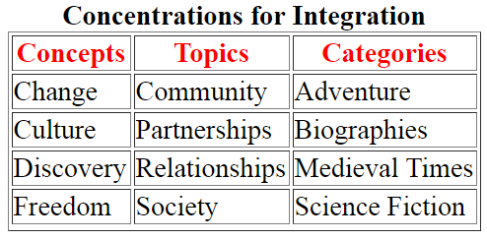
Form Two: Integration of the Curriculum - Across the Disciplines
Themes may be created which address different concentrations.
Three of these are concepts, topics and categories. A few examples include:
2.3
Webbed
(continued)
http://oregonstate.edu/instruction/ed555/zone3/single1.htm

Slide 72
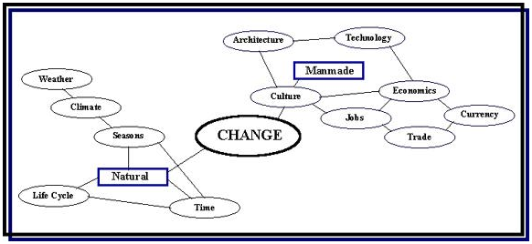
Form Two: Integration of the Curriculum - Across the Disciplines
Webbing
Webbing is a systematic process for recording brainstorming. The process involves all the members of the integrated team, and is used to determine the topics, concepts and skills to be addressed in the curriculum.
The illustration shown below is a simple example of a web for the theme: CHANGE.
2.3
Webbed
(continued)
http://oregonstate.edu/instruction/ed555/zone3/single1.htm

Slide 73
Form Two: Integration of the Curriculum - Across the Disciplines
Brainstorming
There are many procedures for brainstorming and recording the process. No matter which process is used, there are a few guidelines which make brainstorming more effective.
Generate as many ideas as possible.
Accept all ideas.
Seek clarification, if necessary, but do not edit at this stage.
Encourage people to brainstorm on their own before contributing to a common pool of ideas.
Remember that brainstorming is an open-ended exercise. At any time, new ideas or directions may be introduced.
Do not close down the process too soon. Provide ample thinking time.
2.3
Webbed
(continued)
http://oregonstate.edu/instruction/ed555/zone3/single1.htm

Slide 74

Form Two: Integration of the Curriculum - Across the Disciplines
The threaded approach to integration is a metacurricular approach where big ideas are enlarged. This methodology threads thinking skills, social skills, study skills, graphic organizers, technology, and a multiple intelligences (see Howard Gardner)approach to thinking throughout all disciplines.
The threaded approach supersedes all subject matter content. Using this approach, interdepartmental teams can focus on thinking skills to integrate with content information.
2.4
Threaded
http://oregonstate.edu/instruction/ed555/zone3/single1.htm

Slide 75
Form Two: Integration of the Curriculum - Across the Disciplines
The threaded approach takes learning to a synthesis level. That is, teachers incorporate into their teaching strategies such techniques as inquiry and self-reflection.
For example, a teacher may ask the student: what do you think about that? Or, what thinking skills did you use and find most helpful in solving the problem?
2.4
Threaded
(continued)
http://oregonstate.edu/instruction/ed555/zone3/single1.htm

Slide 76

Form Two: Integration of the Curriculum - Across the Disciplines
In an integrated methodology interdisciplinary topics are arranged around overlapping concepts and emergent patterns. This process blends the disciplines by finding overlapping skills, concepts, and attitudes found across the disciplines.
Much like the shared methodology, integration is a result of shifting related ideas out of the subject matter content. An important process of the integrated methodology is that teachers work together on the topics or themes as commonalities emerge.
2.5
Integrated
http://oregonstate.edu/instruction/ed555/zone3/single1.htm

Slide 77

Form Three: Integration of the Curriculum - Within and Across Learners
The immersed methodology focuses all curricular content on interest and expertise. With this methodology, integration takes place within the learners, with little or no outside intervention.
For example, students such as doctoral candidates are generally immersed in a field of study. These students integrate all information and data to answer a question or interest or solve a problem. This immersed study is often undertaken in a field of intense interest or passion.
3.1
Immersed
http://oregonstate.edu/instruction/ed555/zone3/single1.htm

Slide 78
Form Three: Integration of the Curriculum - Within and Across Learners
Similarly, a young child will immerse themselves in drawing pictures or writing stories about subjects which they are extremely interested. This is normal behavior which is often viewed by teachers as obsessive and therefore diverted.
Just as most artists and writers have a passion for their field, immersed learners continually make connections between their chosen topic of interest and subjects. Immersion takes advantage of this intense interest and allows students to make these connections and self-direct their learning based on those interests.
3.1
Immersed
(continued)
http://oregonstate.edu/instruction/ed555/zone3/single1.htm

Slide 79

Form Three: Integration of the Curriculum - Within and Across Learners
A networked methodology creates multiple dimensions and directions of focus. Like brainstorming, it provides various ideas and ways of discovering.
The networked methodology is totally student centered. It professes that only the learner can direct the integration process. The methodology proposes that the learner knows their topic and can self-direct their focus on the necessary resources both within and across subject areas.
Networks are created between the learner and various information systems, subject matter experts, and others who have an interest, experience or knowledge of the topic or theme.
3.2
Networked
Adapted from the original work of Robin Fogarty [Fogarty, R. (1991). Ten ways to integrate curriculum.
Educational Leadership. 49(2), pp61-65.
http://oregonstate.edu/instruction/ed555/zone3/single1.htm

Slide 80
Alex Pomson
Department of Education, Hebrew University
http://www.lookstein.org/integration/curriculum_making.htm
Why integrate?
Administrative: Most efficient use of resources and time. With integration, you can achieve many curriculum objectives at the same time.
Cognitive: Brain-based research suggests that learning is more effective/meaningful when it is integrated - embedded in connections.

Slide 81
Epistemological (about the theory of knowledge): Integration transcends artificial distinctions made between disciplines/bodies of knowledge.
Ideological: Promotes the idea that Judaism is relevant to all aspects of students' lives, and that Jewish lives are enriched by drawing on worldly wisdom/modernity.

Slide 82
Psychological: Enable children to develop integrated personalities in which all parts of their school lives are inter-related.
Practical: In a knowledge-rich society students are better empowered by the acquisition of skills than by accumulating greater quantities of material. Skills transcend subject matter.
Theological: God didn't only create Torah. He created the world. Separating kodesh and chol diminishes God.

Slide 83
Why not integrate?
Administrative: Team teaching/interdisciplinary coordination requires more planning time. It may also require more than one teacher to work with the same class at the same time.
Epistemological: Disciplines are different. Subjects are ends in themselves. Integration undermines their integrity.
Religious: Integration threatens the distinct role and status of limmudei kodesh by blurring or removing the boundaries between kodesh and chol.

Slide 84
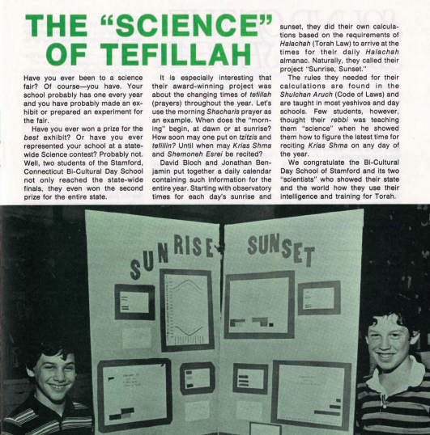
chinuch.org

Slide 85
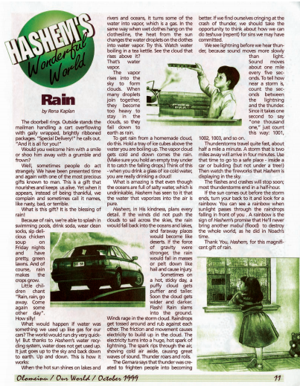
chinuch.org

Slide 86
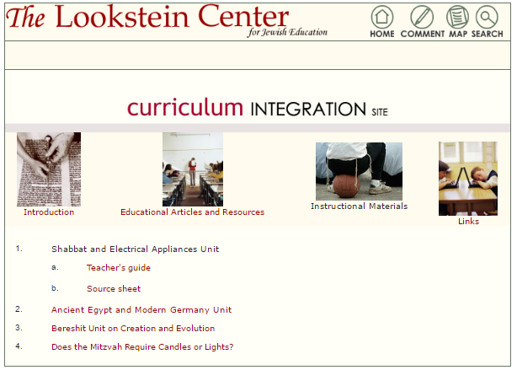
http://www.lookstein.org/integration/curriculum_instruct.htm

Slide 87
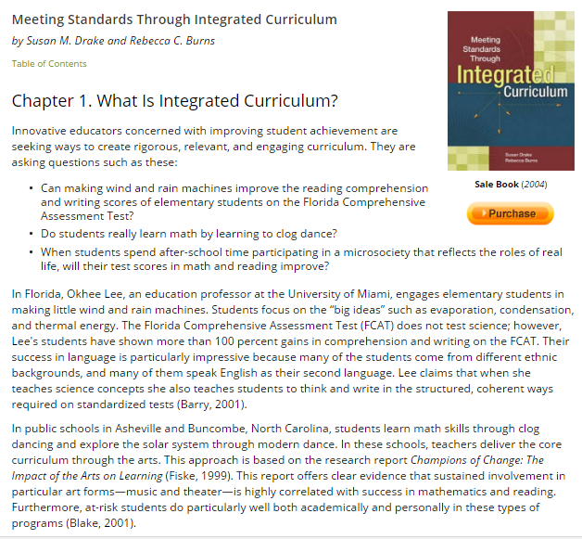
http://www.ascd.org/publications/books/103011/chapters/What-Is-Integrated-Curriculum%C2%A2.aspx

