Slide 1
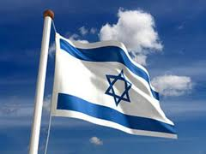
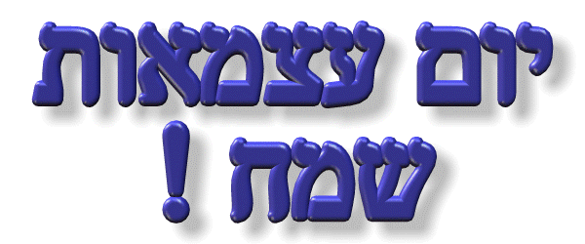
MFS
Yom Ha’Atzma’ut Quiz
5784 / 2024
76 Years of the State of Israel

Slide 2
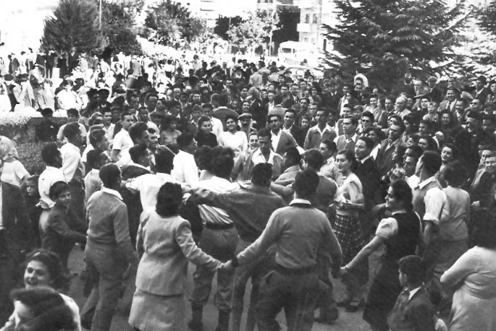
The First Yom Ha’Atzma’ut, 1948

Slide 3
Declaration of Independence of the
State of Israel
1948
CLICK HERE

Slide 4
1. Who is the current Prime Minister of Israel?
a. Ariel Sharon
b. Binyamin Netanyahu
c. Naftali Bennett
d. Shimon Peres

Slide 5
2. Who was Israel’s first Prime Minister?
a. Golda Meir
b. Yitzhak Rabin
c. Menachem Begin
d. David Ben Gurion

Slide 6
3. Israel’s parliament is called:
a. Parliament
b. The Parliament
c. The Knesset
d. Congress

Slide 7
4. The lowest body of water on Earth’s surface is:
a. The Dead Sea
b. Lake Hula
c. The Kineret
d. The Jordan River

Slide 8
5. What is the name of the desert found in the south of Israel?
a. Sahara
b. Negev
c. Sinai
d. Ashkelon

Slide 9
6. What is the current population of Israel?
a. 6.5 million
b. 12.2 million
c. 9.9 million
d. 15.5 million

Slide 10
7. In 1984 and 1991, Israel airlifted a total of 22000 Jews from which country?
a. France
b. Russia
c. Yemen
d. Ethiopia

Slide 11
8. Israel’s national anthem – ‘Hatikva’ means:
a. Peace
b. The Hope
c. Together
d. The future

Slide 12
9. How old is Israel?
a. 68
b. 56
c. 74
d. 76

Slide 13
10. Which city in Israel has the largest population?
a. Jerusalem
b. Haifa
c. Tel Aviv
d. Eilat

Slide 14
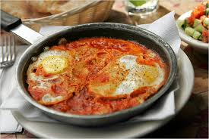
11. Name the following Israeli dish:
a. Shwarma
b. Malawach
c. Falafel
d. Shakshuka

Slide 15
12. The currency in Israel is called the
a. Pound
b. Yen
c. Dollar
d. Shekel

Slide 16
13. What is the name of the main airport in Israel?
a. Sharon
b. Tel aviv
c. Ben Gurion
d. Golan

Slide 17
14. Which king made Jerusalem the capital of Israel?
a. King Solomon
b. King David
c. King Saul
d. None of the above

Slide 18
15. The slang word ‘magniv’ means
a. Let’s go
b. Cool!
c. Yes!
d. Not a big deal

Slide 19
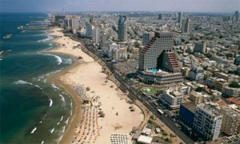
16. Which Israeli city does the picture show?
a. Haifa
b. Eilat
c. Be’er Sheva
d. Tel Aviv

Slide 20
17. Which one of the following is not found in an Israeli salad?
a. Tomatoes
b. Mushrooms
c. Onions
d. Cucumbers

Slide 21
18. The largest river in Israel is called the
a. Jordan River
b. Kinneret
c. Dan River
d. Yarkon River

Slide 22
19. In slang, the word ‘balagan’ means:
a. Cool
b. Let’s go
c. A Big Mess
d. Awesome

Slide 23
20. The Holocaust memorial centre in Jerusalem is called:
a. Sharon
b. Yad Vashem
c. Jerusalem Place
d. Weizmann Institute

Slide 24
ANSWERS

Slide 25
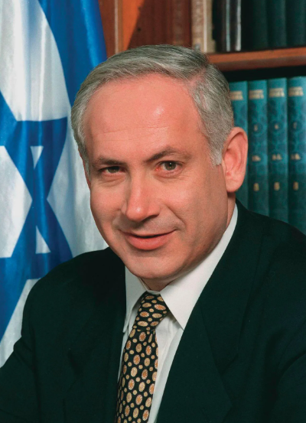
1. Who is the current Prime Minister of Israel?
a. Ariel Sharon
b. Binyamin Netanyahu
c. Naftali Bennett
d. Shimon Peres

Slide 26
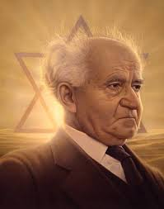
2. Who was Israel’s first Prime Minister?
a. Golda Meir
b. Yitzhak Rabin
c. Menachem Begin
d. David Ben Gurion

Slide 27
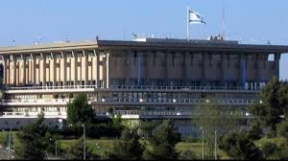
3. Israel’s parliament is called:
a. Parliament
b. The Parliament
c. The Knesset
d. Congress

Slide 28
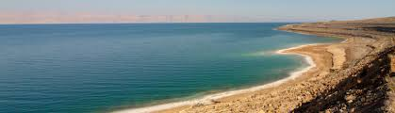
4. The lowest body of water on Earth’s surface is:
a. The Dead Sea
b. Lake Hula
c. The Kineret (Kineret is the lowest freshwater lake on Earth)
d. The Jordan River

Slide 29
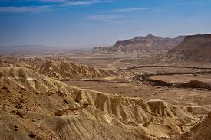
5. What is the name of the desert found in the south of Israel?
a. Sahara
b. Negev
c. Sinai
d. Ashkelon

Slide 30
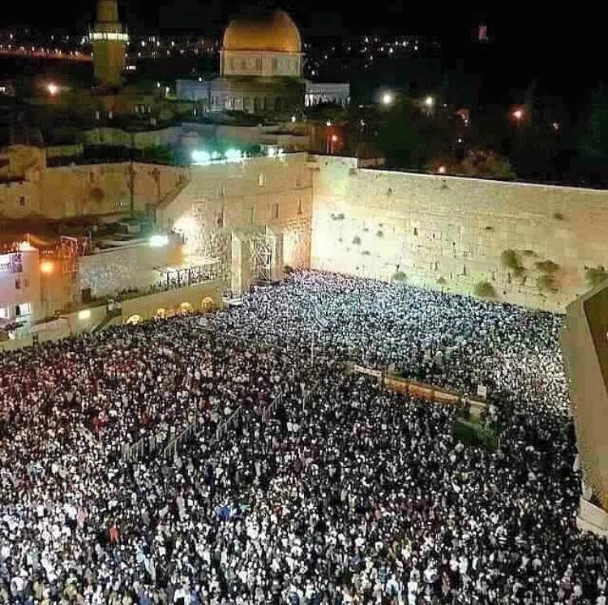
6. What is the population of Israel?
a. 6.5 million
b. 12.2 million
c. 9.9 million
d. 15.5 million

Slide 31
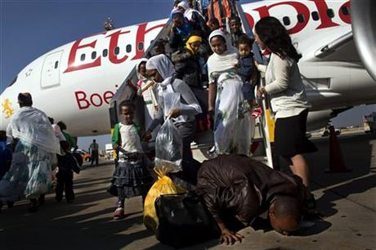
7. In 1984 and 1991, Israel airlifted a total of 22000 Jews from which country?
a. France
b. Russia
c. Yemen
d. Ethiopia

Slide 32
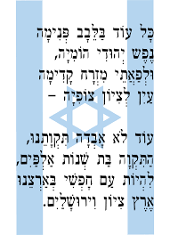
8. Israel’s national anthem – ‘Hatikva’ means:
a. Peace
b. The Hope
c. Together
d. The future

Slide 33
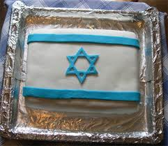
9. How old is Israel?
a. 68
b. 56
c. 74
d. 76

Slide 34
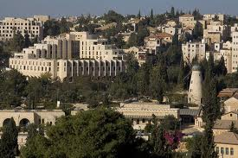
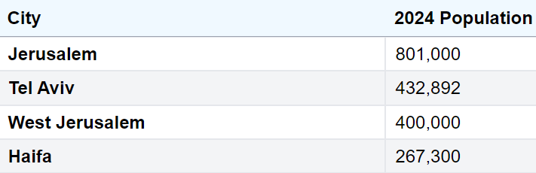
10. Which city in Israel has the largest population?
a. Jerusalem
b. Haifa
c. Tel Aviv
d. Eilat

Slide 35
11. Name the following Israeli dish:
a. Shwarma
b. Malawach
c. Falafel
d. Shakshuka

Slide 36
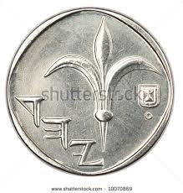
12. The currency in Israel is called the
a. Pound
b. Yen
c. Dollar
d. Shekel

Slide 37
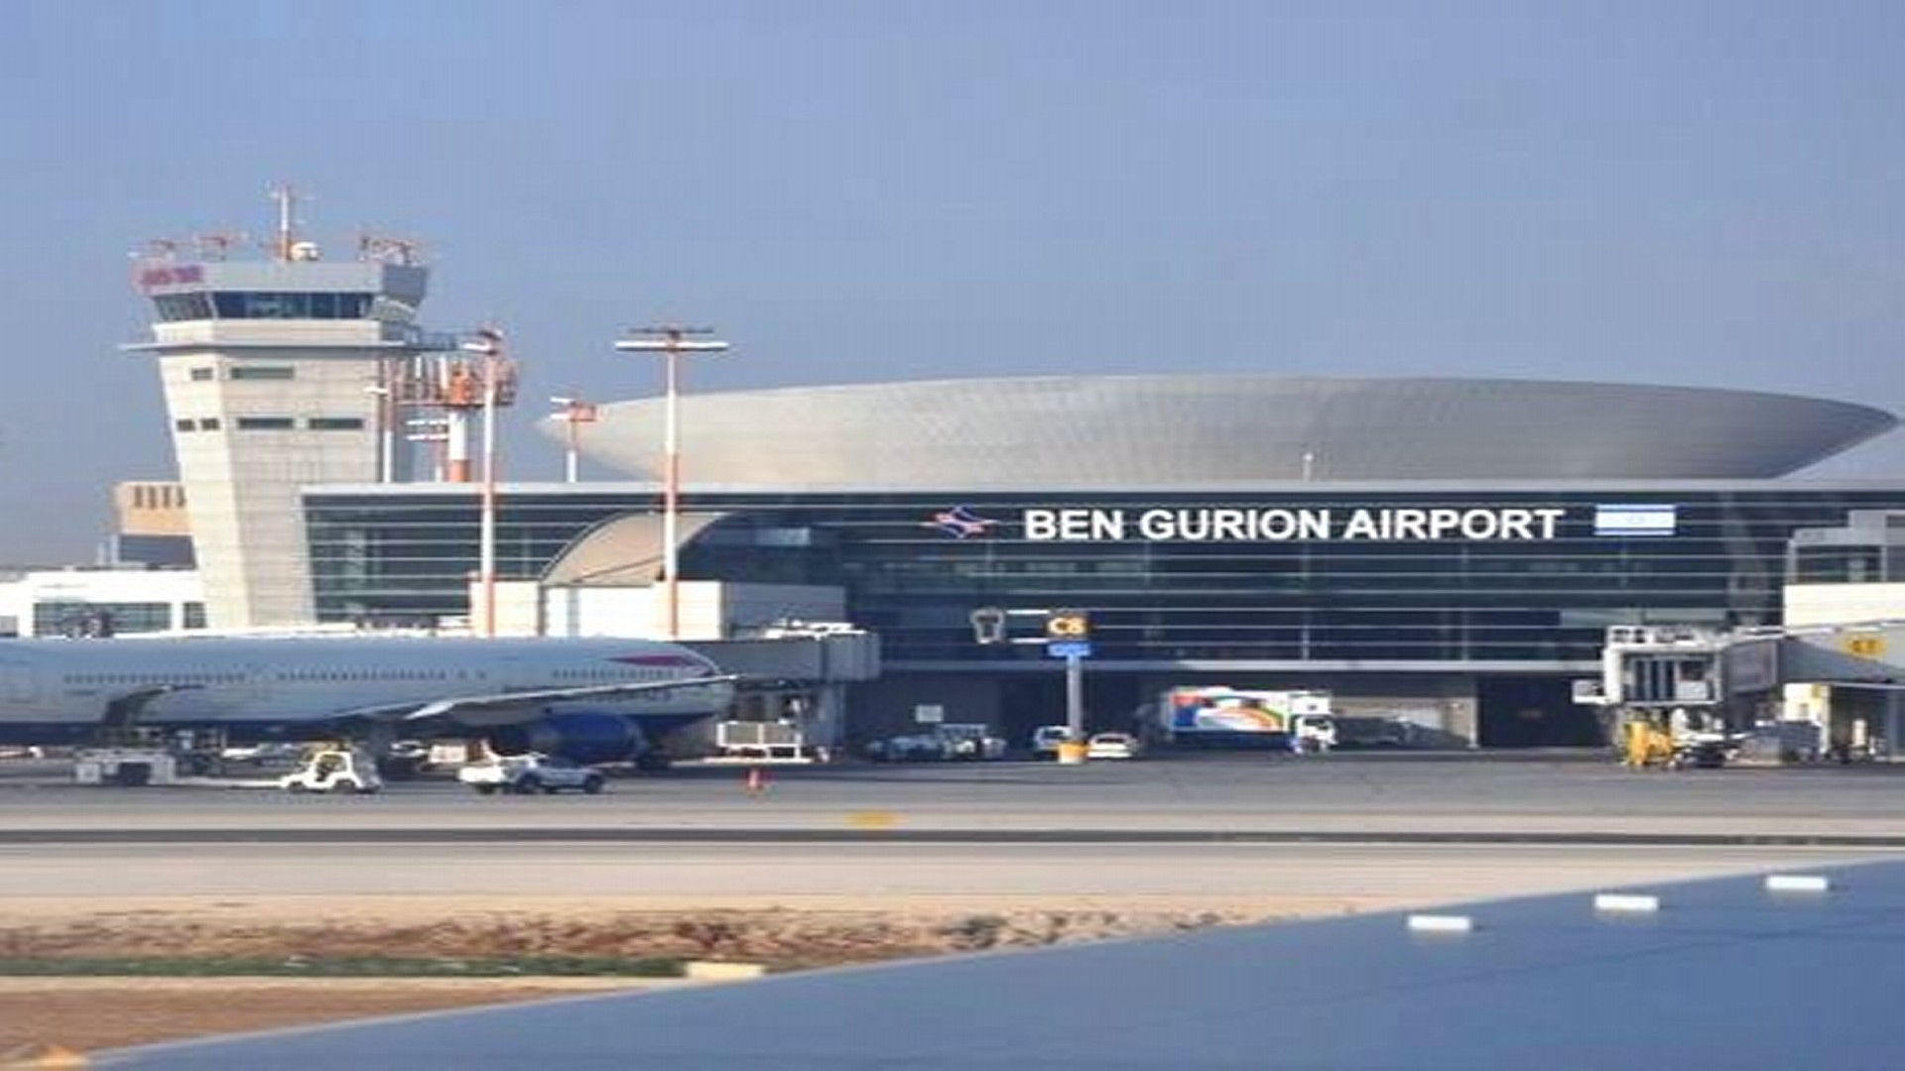
13. What is the name of the main airport in Israel?
a. Sharon
b. Tel aviv
c. Ben Gurion
d. Golan

Slide 38
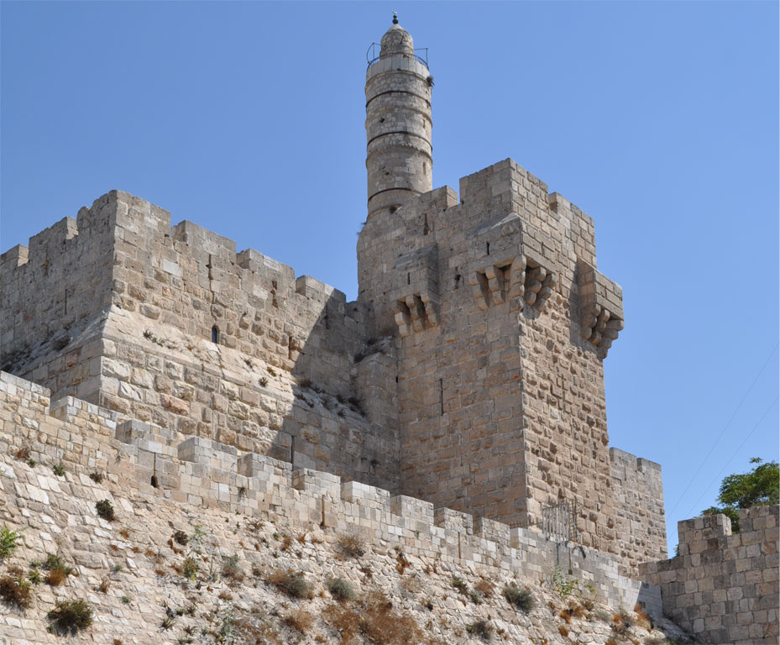
14. Which king made Jerusalem the capital of Israel?
a. King Solomon
b. King David
c. King Saul
d. None of the above
King David’s Tower

Slide 39

15. The slang word ‘magniv’ means
a. Let’s go
b. Cool!
c. Yes!
d. Not a big deal

Slide 40
16. Which Israeli city does the picture show?
a. Haifa
b. Eilat
c. Be’er Sheva
d. Tel Aviv

Slide 41
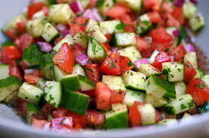
17. Which one of the following is not found in an Israeli salad?
a. Tomatoes
b. Mushrooms
c. Onions
d. Cucumbers

Slide 42
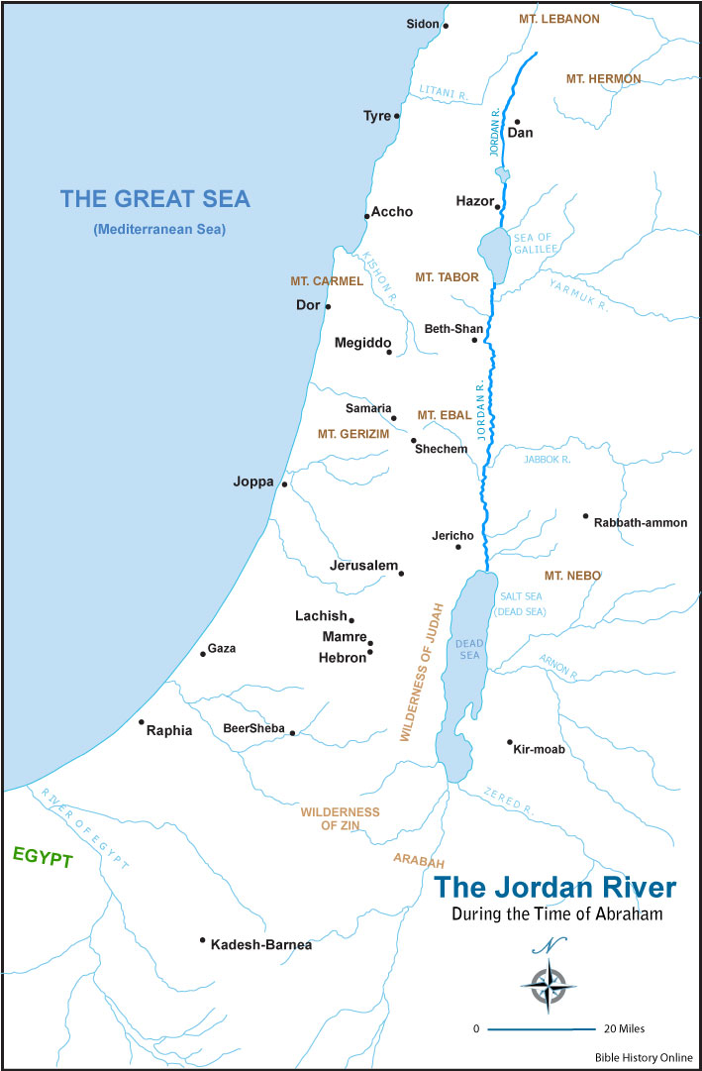
18. The largest river in Israel is called the
a. Jordan River
b. Kinneret
c. Dan River
d. Yarkon River

Slide 43
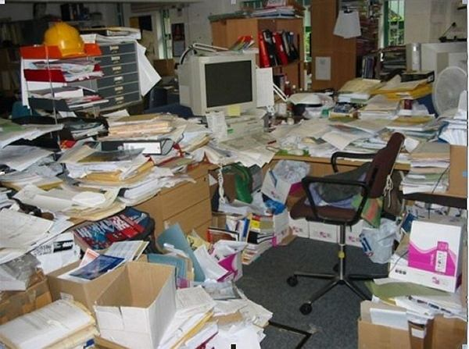
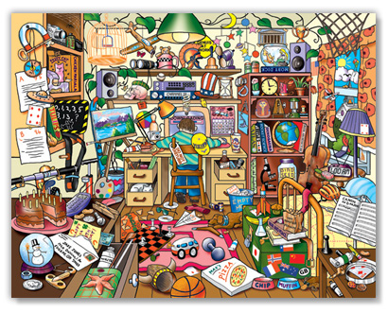
19. In slang, the word ‘balagan’ means:
a. Cool
b. Let’s go
c. A Big Mess
d. Awesome

Slide 44

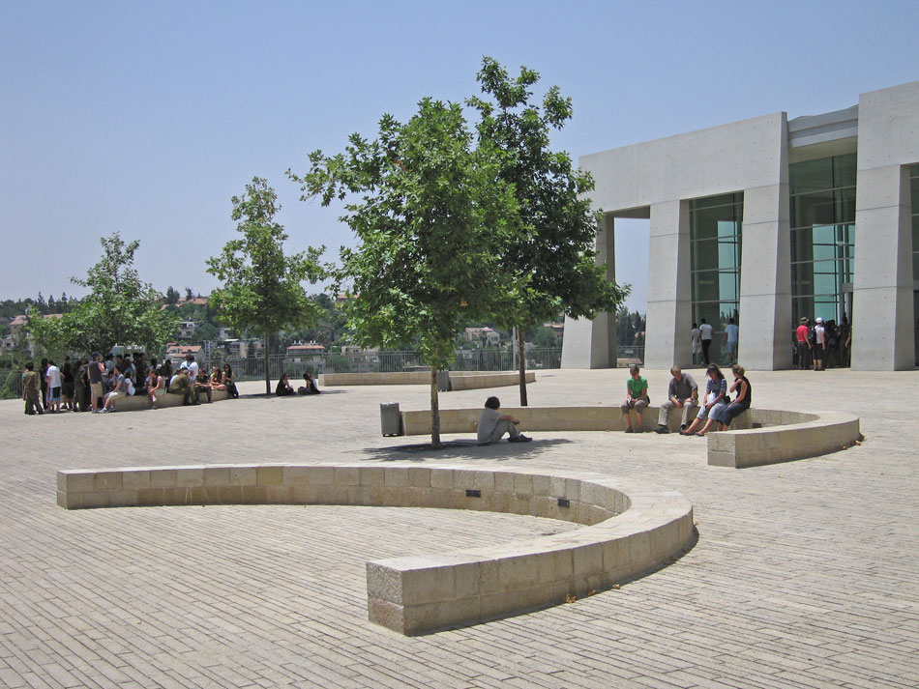
20. The Holocaust memorial centre in Jerusalem is called:
a. Sharon
b. Yad Vashem
c. Jerusalem Place
d. Weizmann Institute

